Slide 1
UrbanEstate Online property dealing site
Presented By
Ajinkya Rokade(229007)
Nikhil Dhage(229175)

Slide 2
Points to be discussed
Specification
Future Scope
Conclusion
Introduction
Objectives
UML Diagrams
Screenshots
S/W and H/W
Requirement

Slide 3
introduction
UrbanEstate provides common platform for certified sellers and customers to rent, sell, buy properties including flats, bungalow, plots, commercial offices, shops and student PG etc.
It will also bridge the gap between customers and certified property sellers, where sellers will be able to advertise their properties on this platform and customers will be able to search for properties, view property details, book appointment, contact property owners or agents, book and reserve properties, review sellers and properties and make payments through the platform both with comfort of their home.
The motive of developing this application is to design a feature rich search engine which can make the search of commercial land/properties an easy task

Slide 4
Objectives
This is initiative to create an online platform for customers to rent/buy properties at best and competitive price and will act as a broker between customer and seller with zero brokerage fees.
This platform will reduce the hassle of people looking for properties, So UrbanEstate provides one stop solution for such problem.
UrbanEstate provides simple yet effective platform for property dealing.

Slide 5
Technologies used
Front End – React
Back End – Java Spring Boot
Database – MySql

Slide 6
UML Diagrams

Slide 7
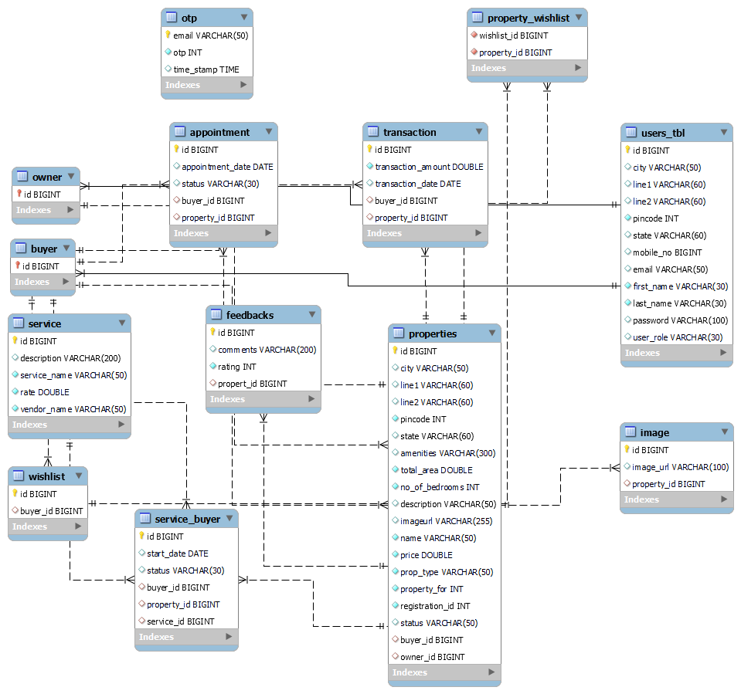
E-R Diagram

Slide 8
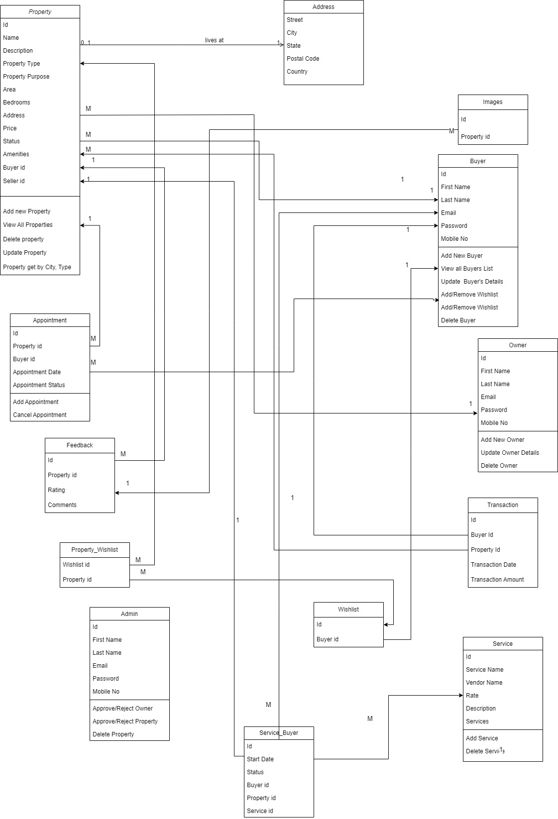
Class diagram

Slide 9
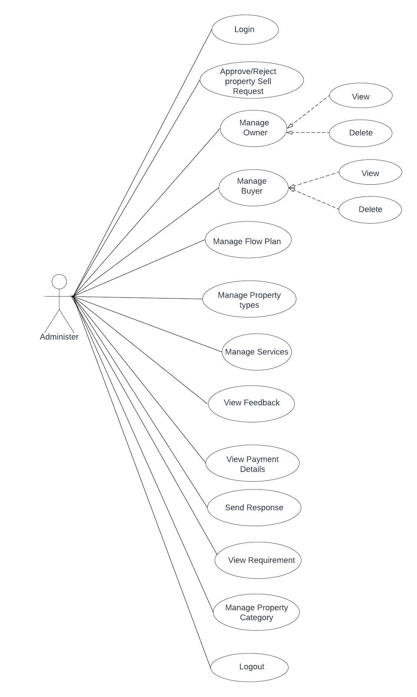
Admin use case diagram

Slide 10
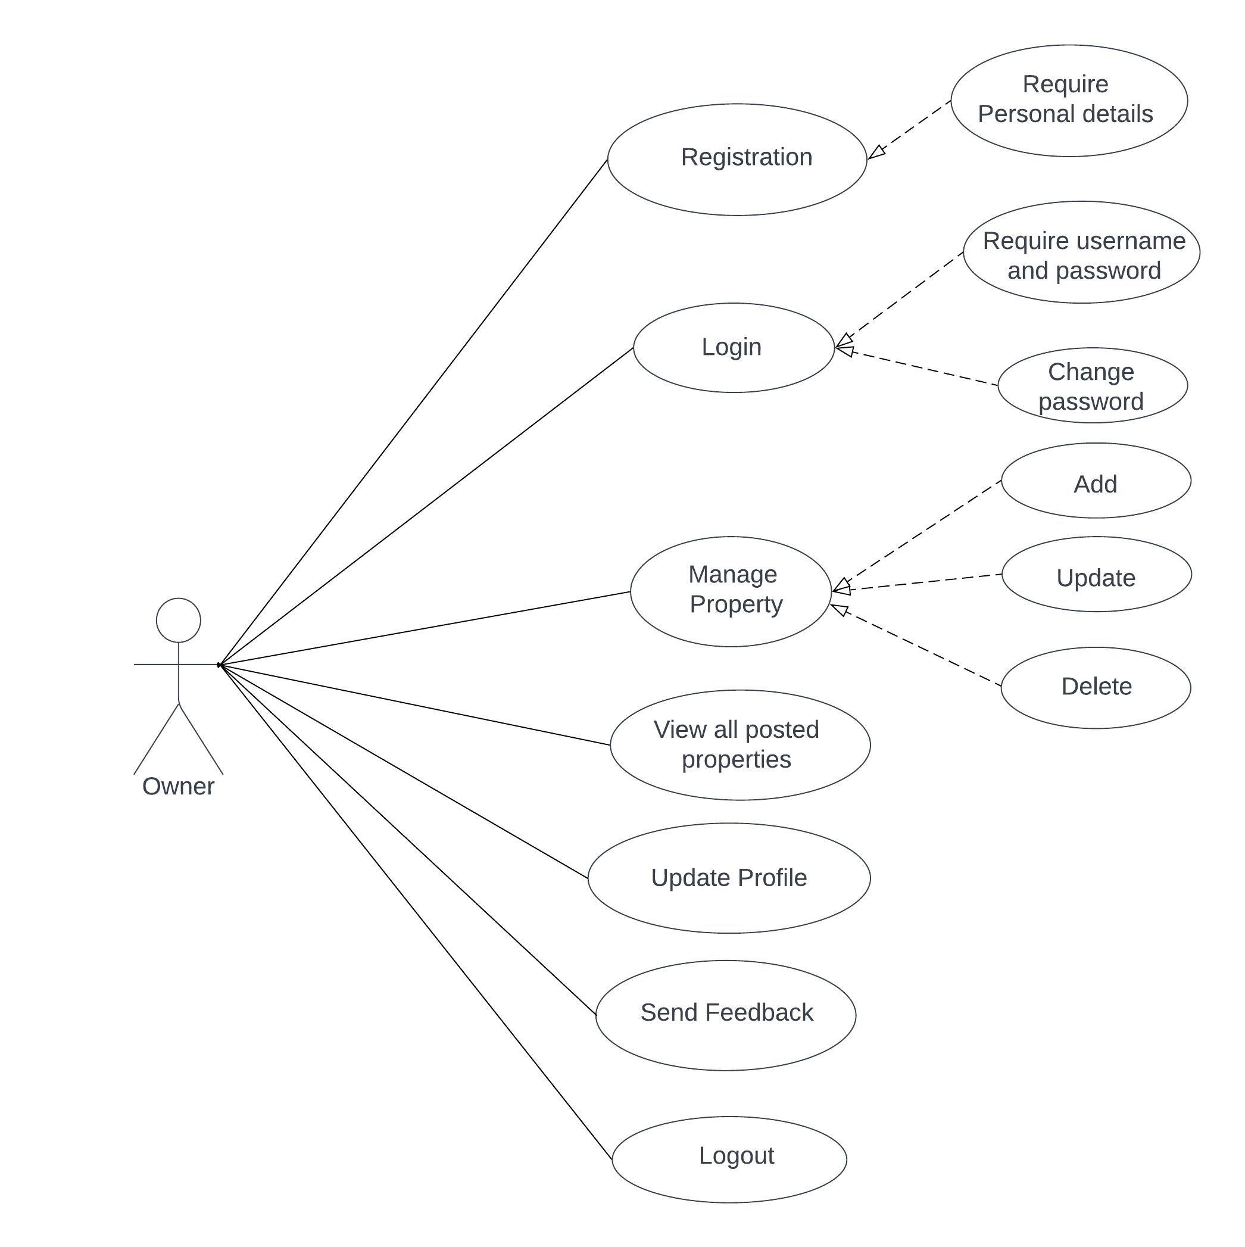
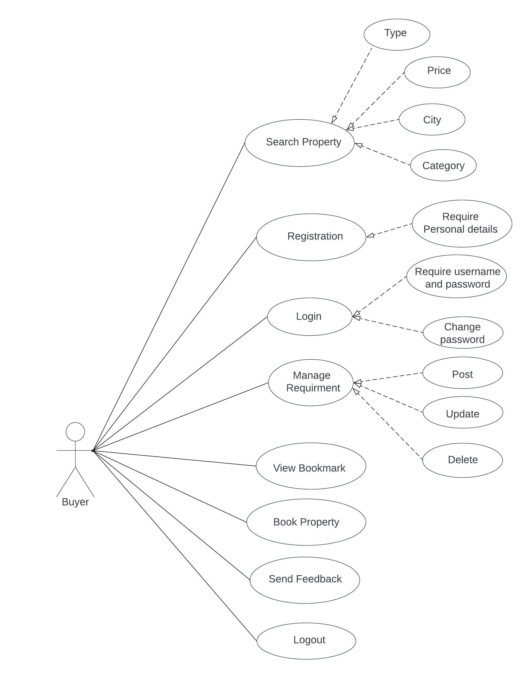
Owner and buyer use case diagram

Slide 11
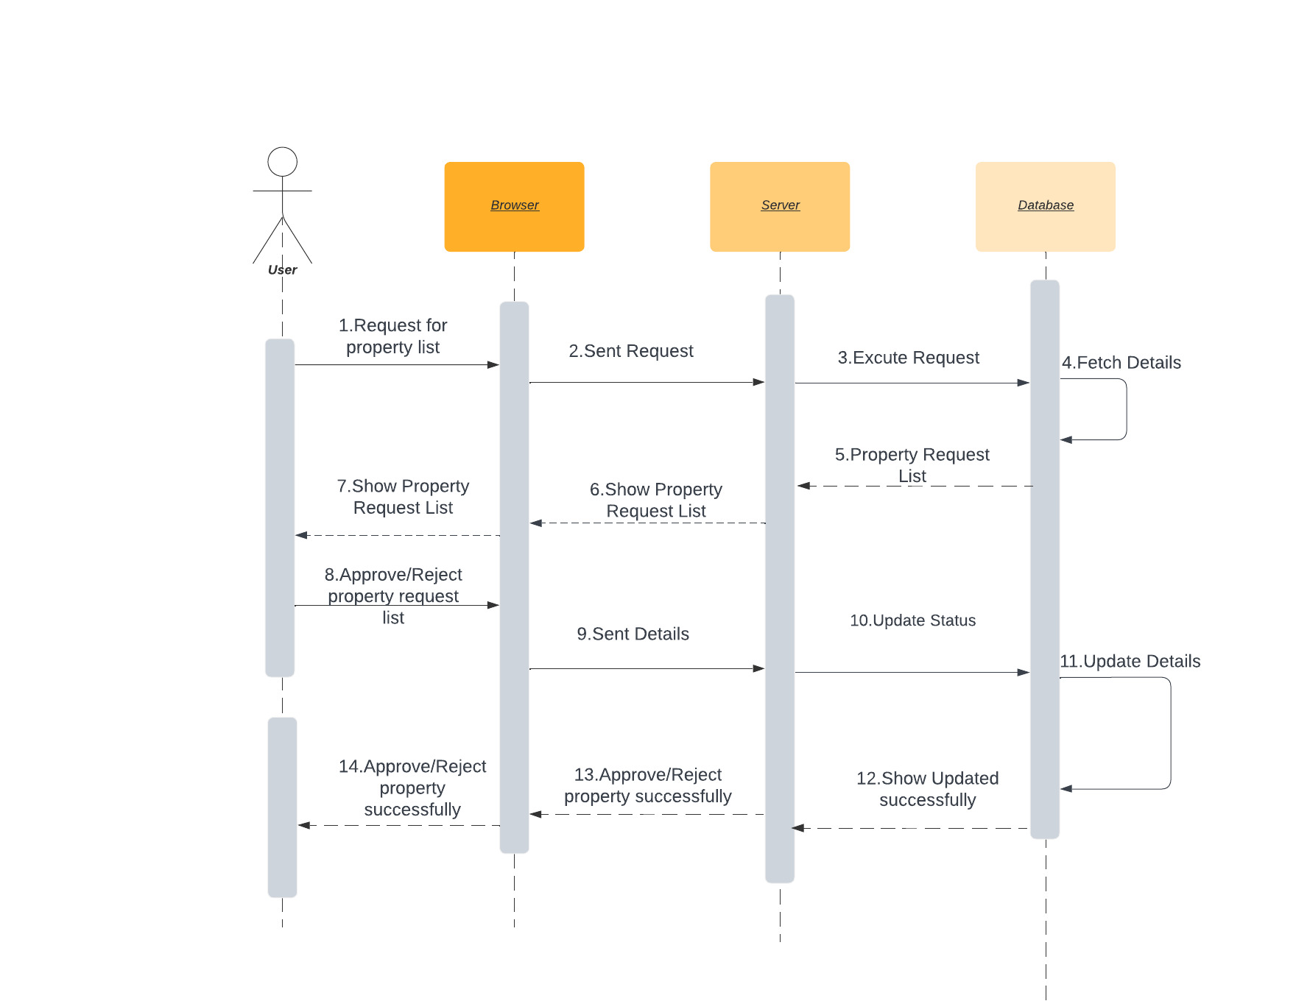
Sequence diagrams

Slide 12
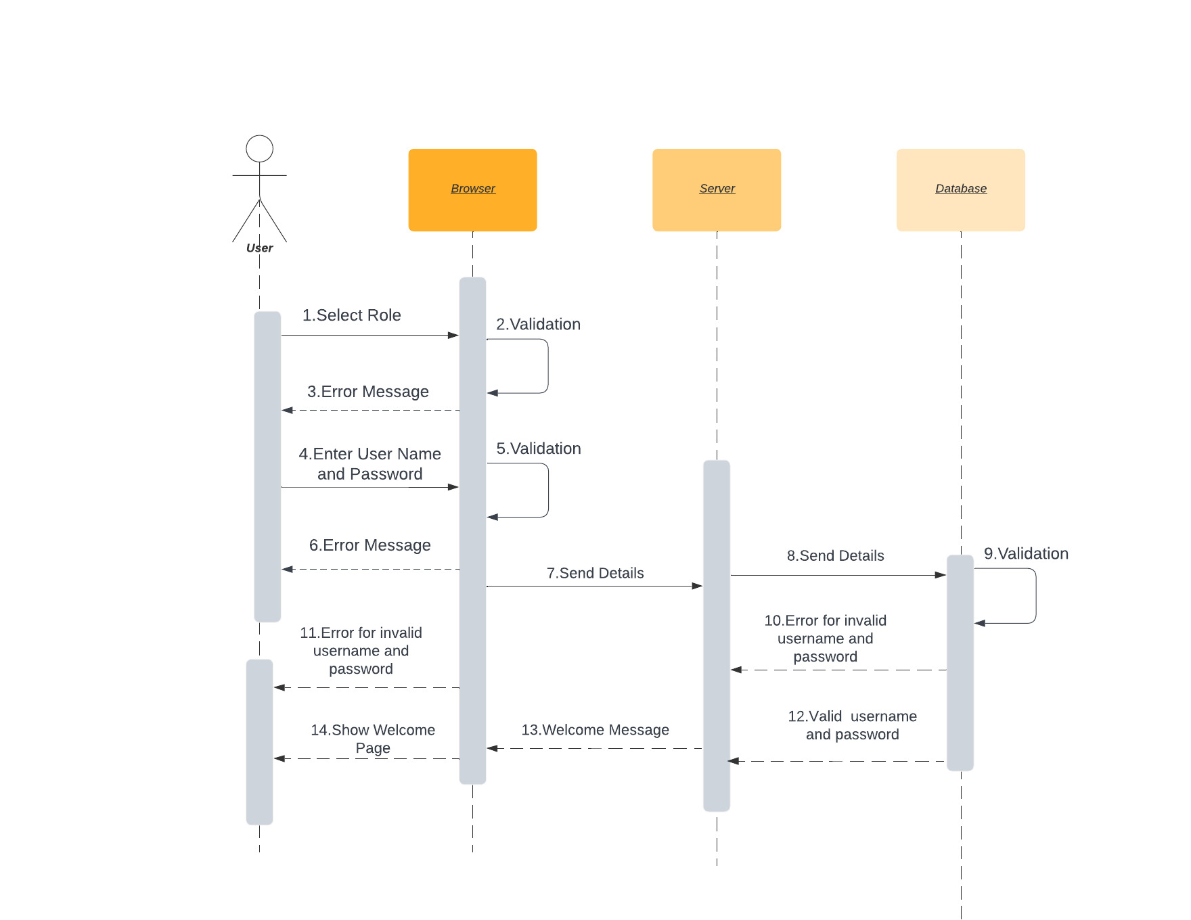
Login sequence

Slide 13
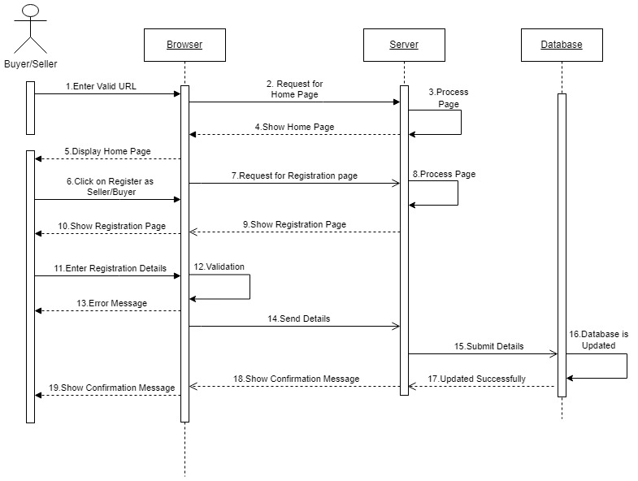
Registration sequence

Slide 14
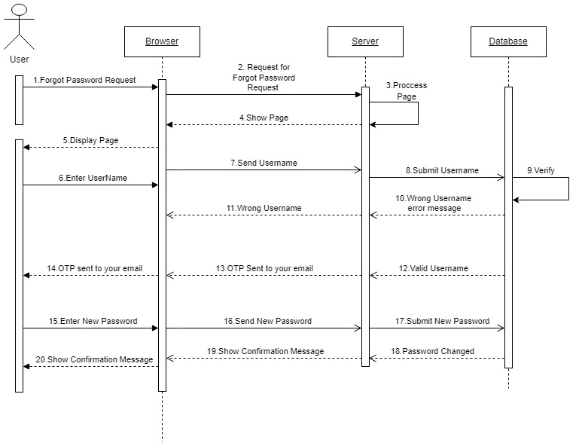
Forgot password sequence

Slide 15
screenshots

Slide 16
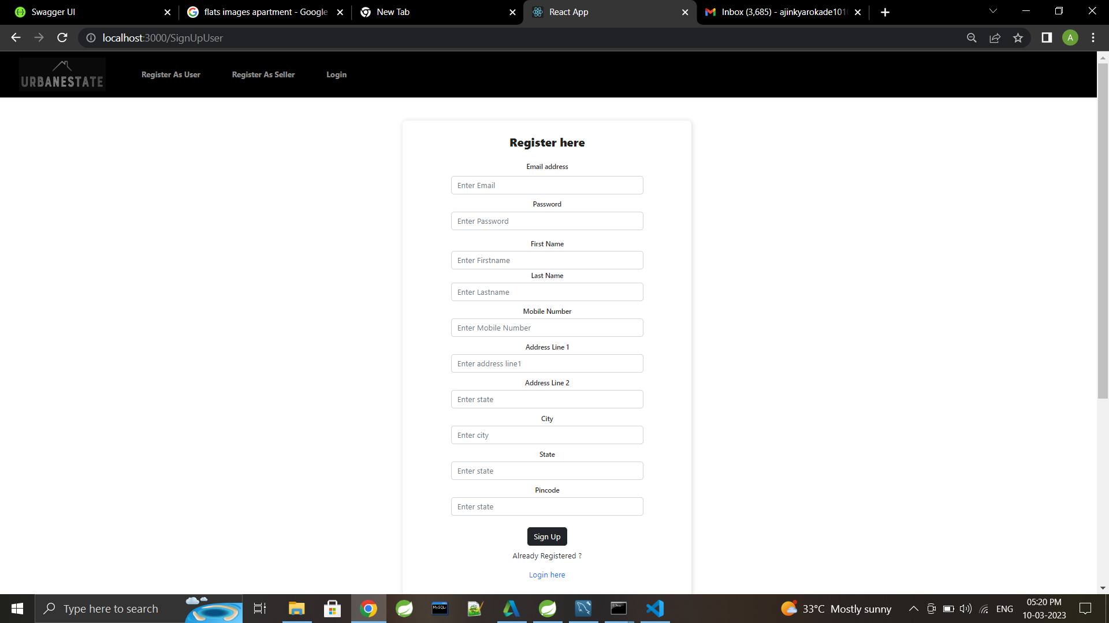
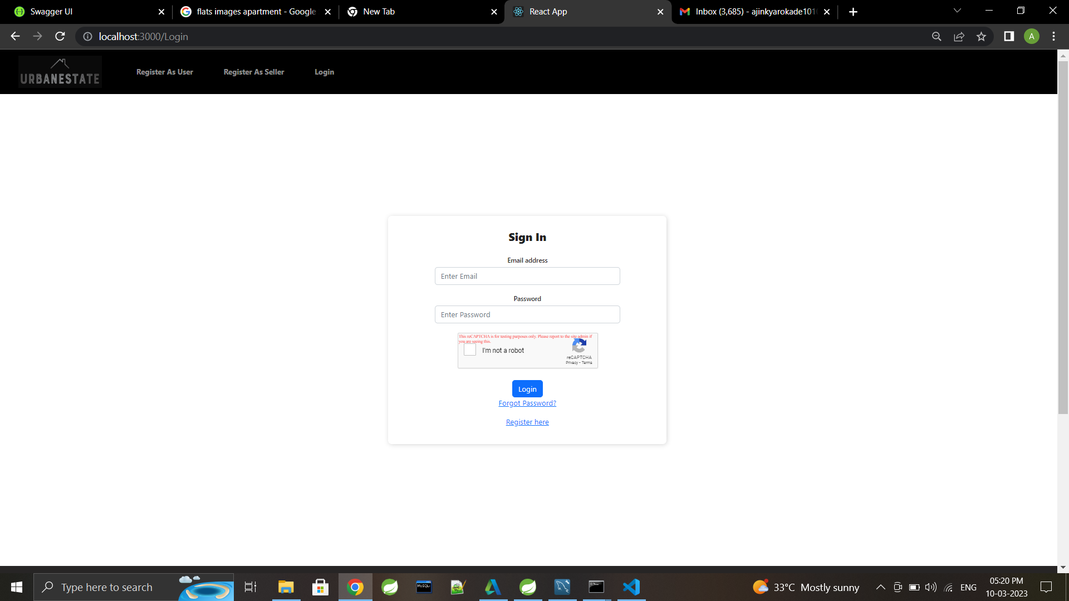
User registration and login page

Slide 17
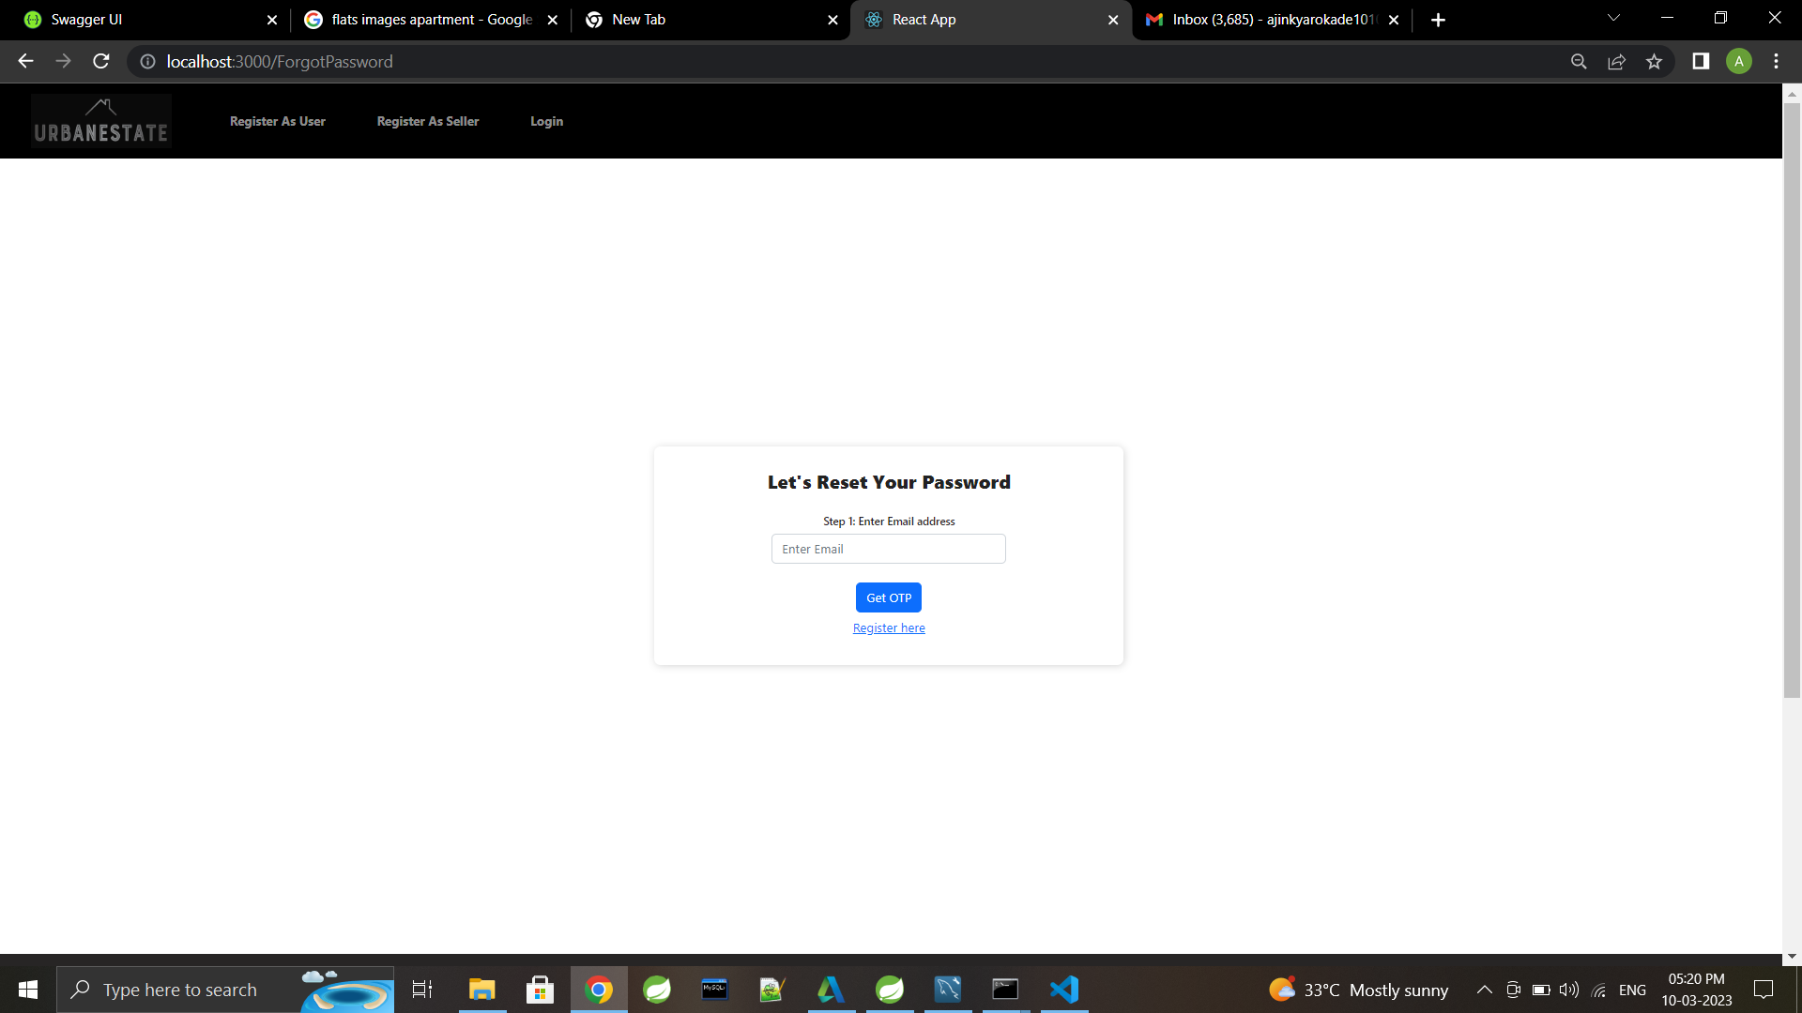
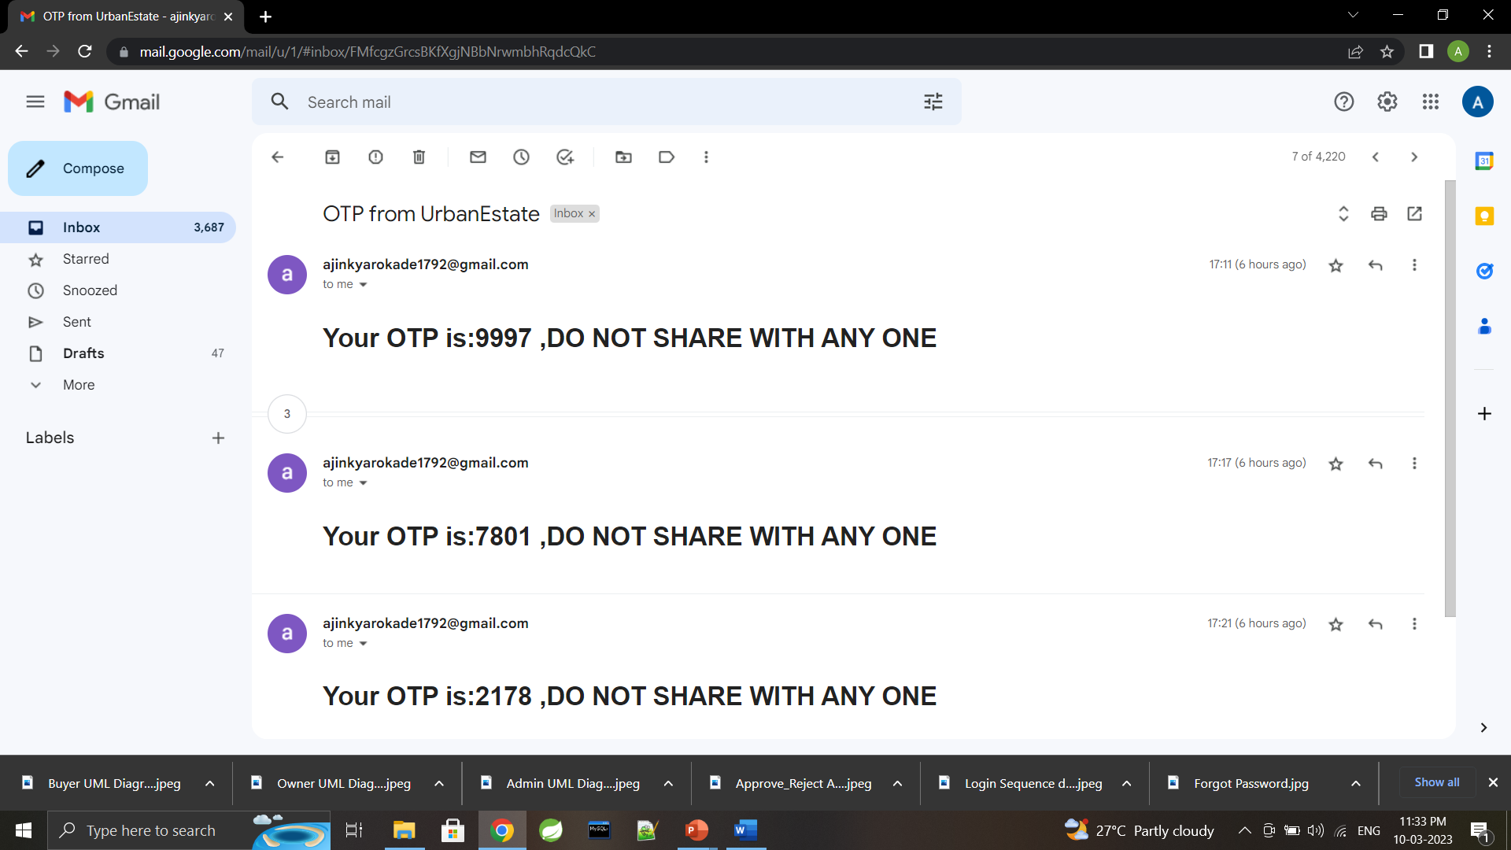
Reset password and email from urbanestate

Slide 18
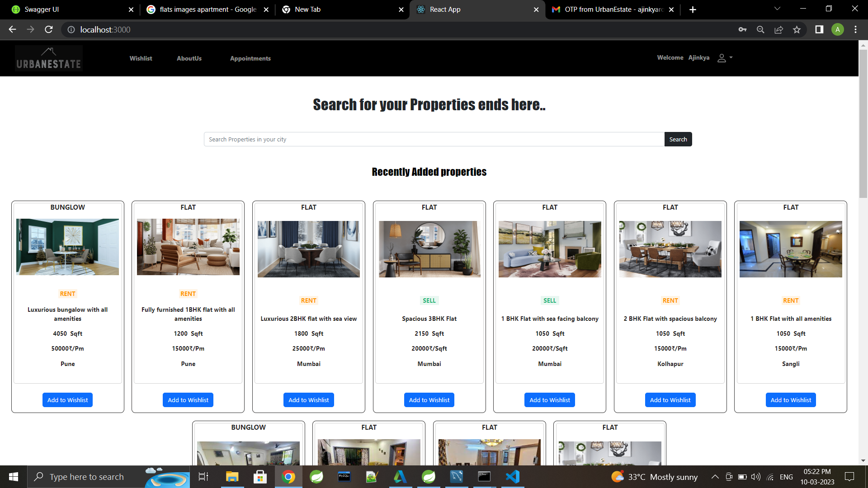
Dashboard after successful login

Slide 19
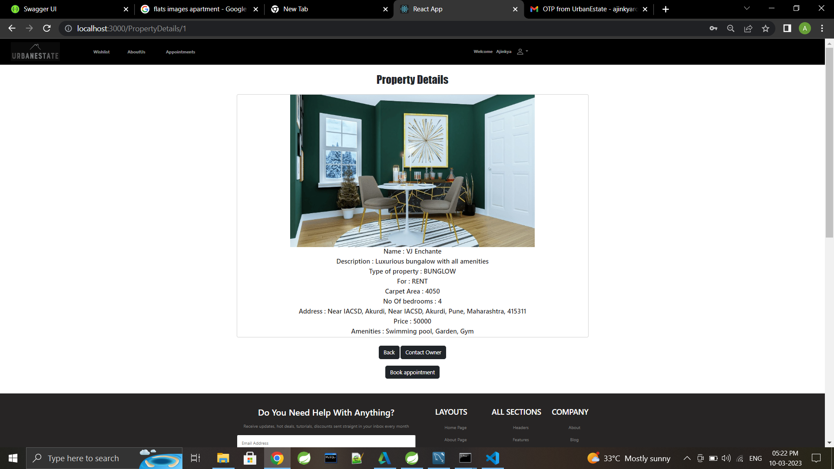
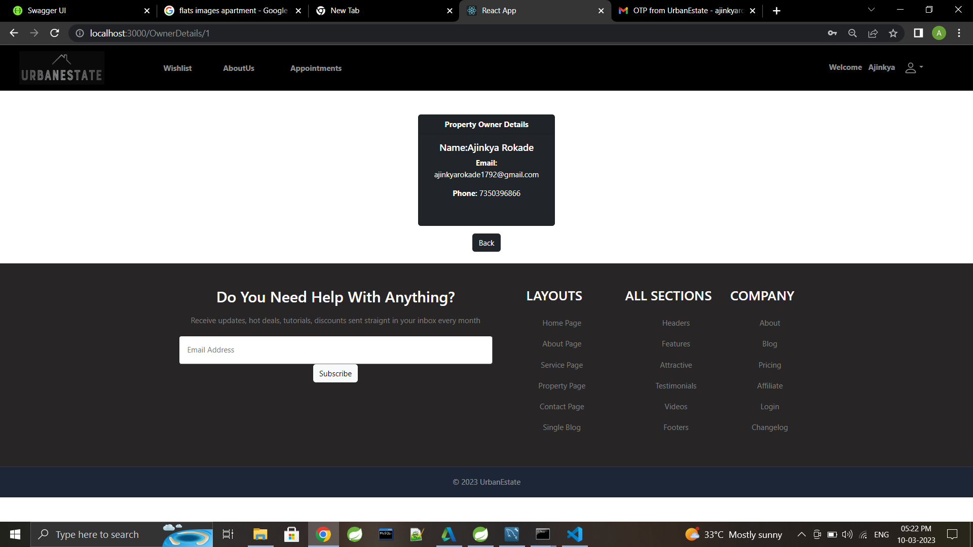
Property and owner details

Slide 20
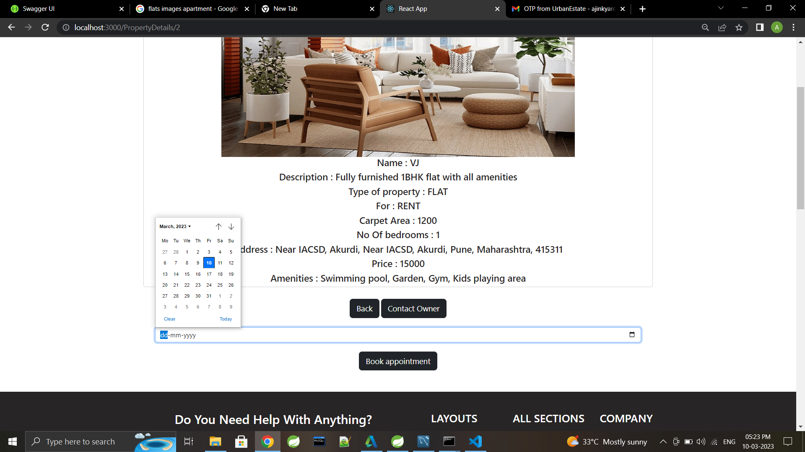
Book appointment

Slide 21
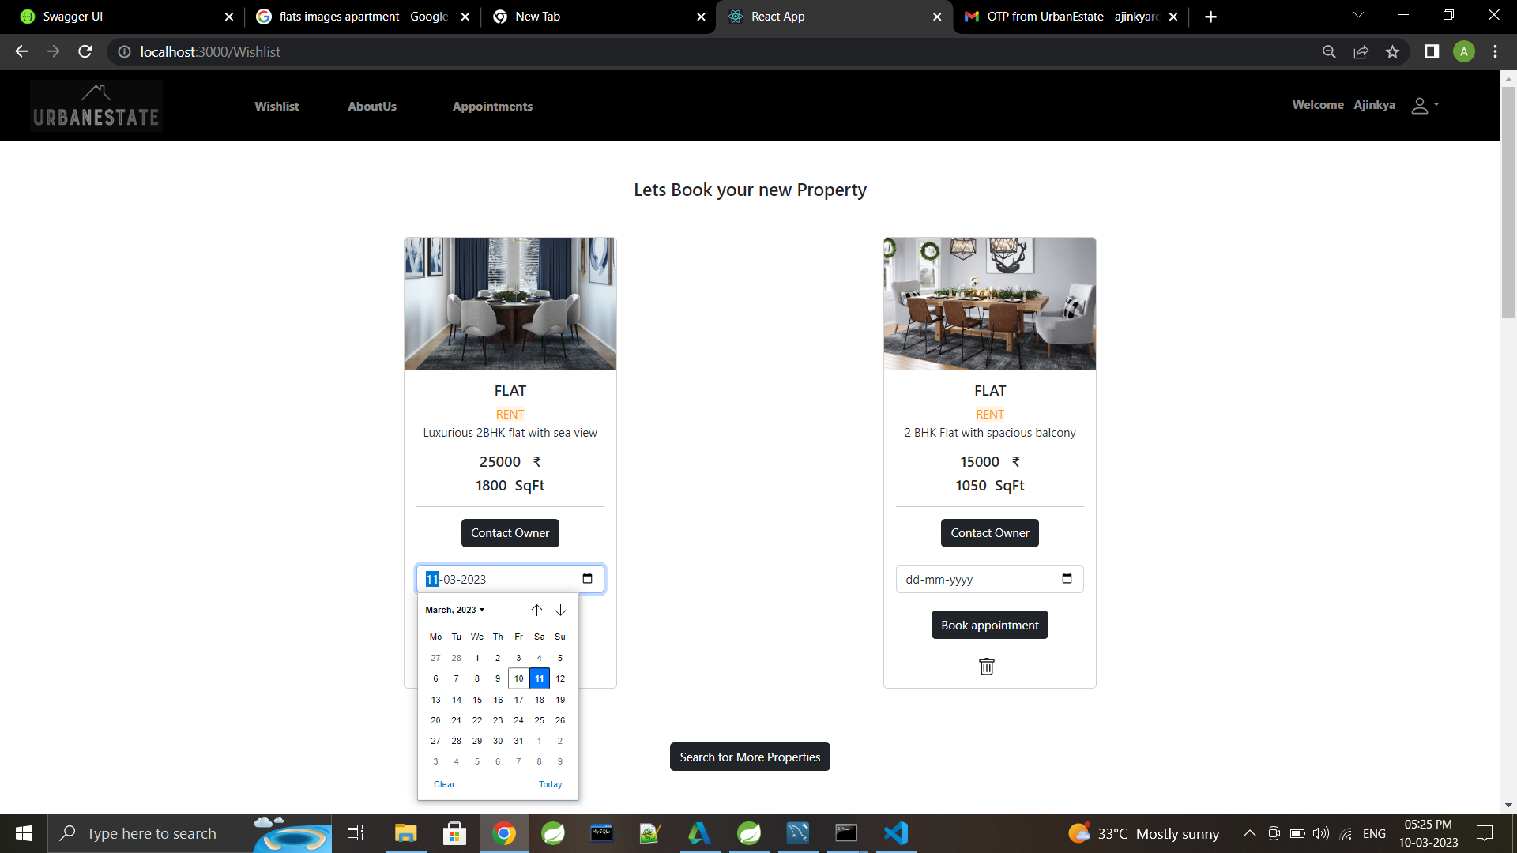
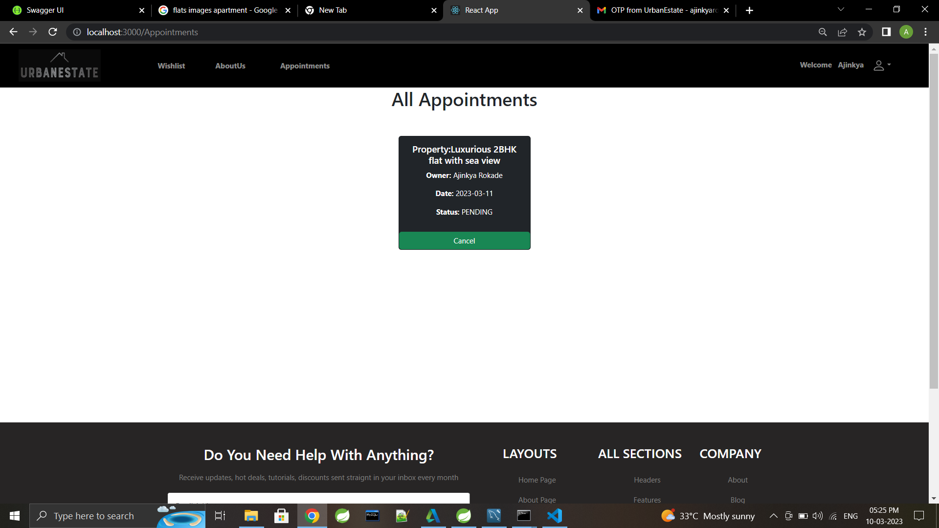
Appointments and Wishlist

Slide 22
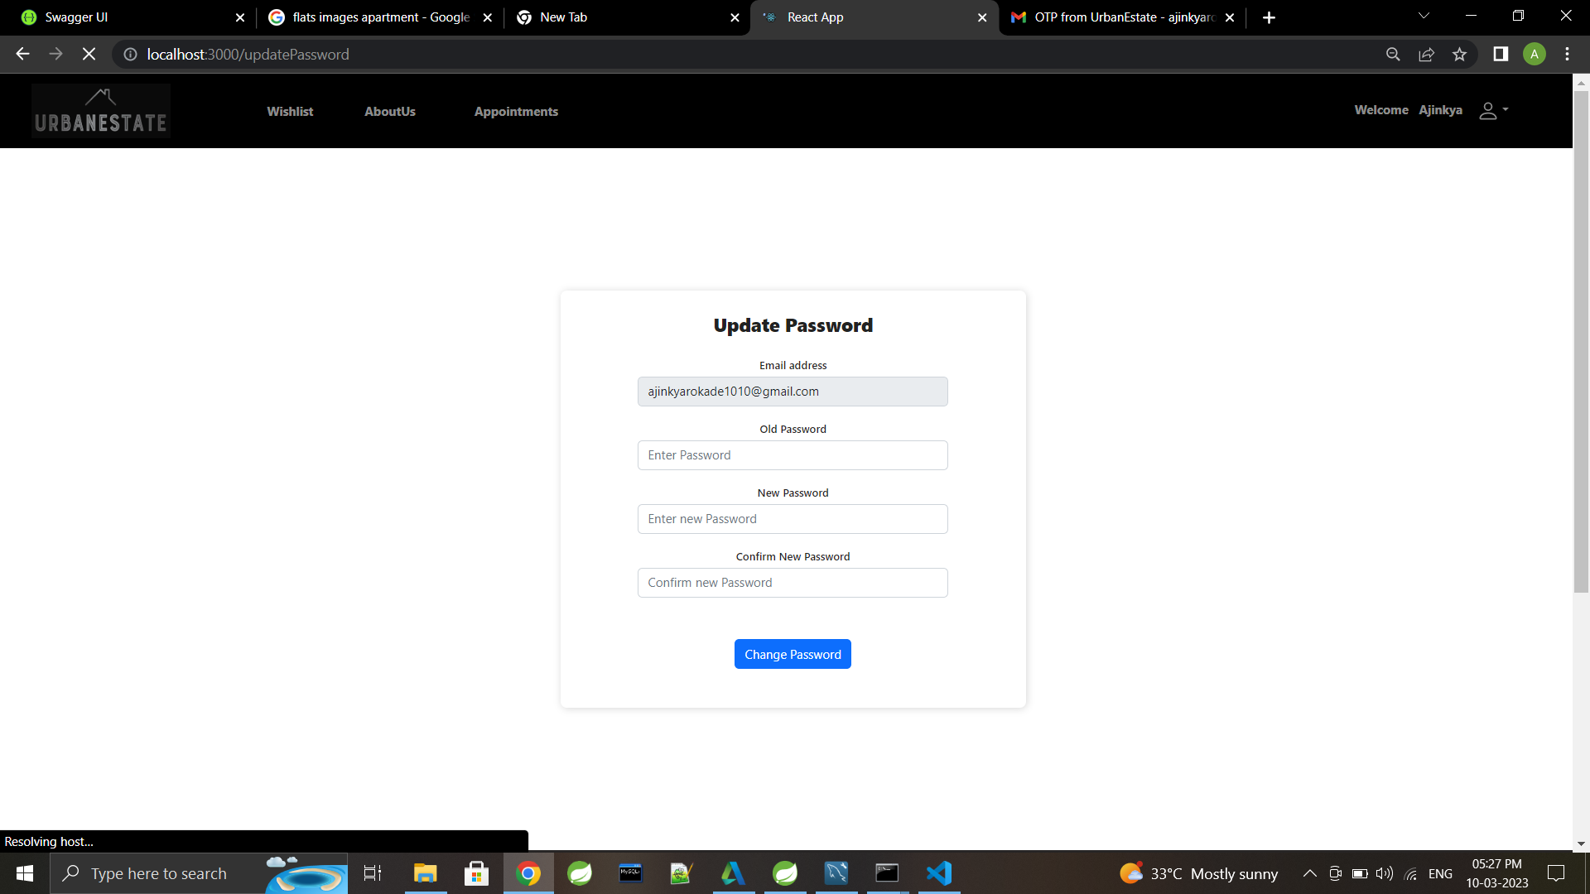
Update password

Slide 23
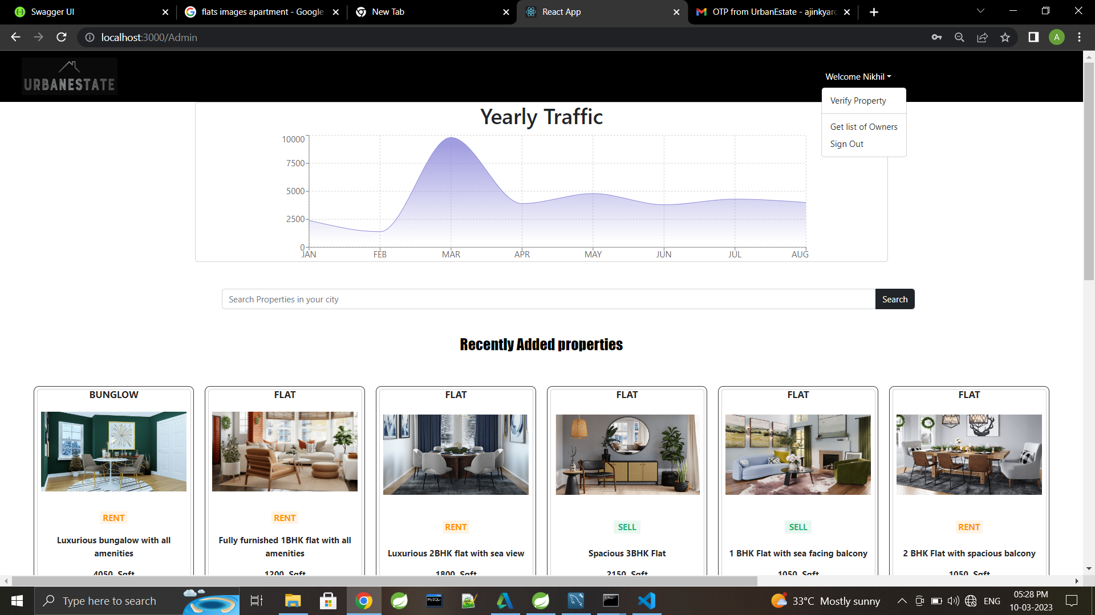
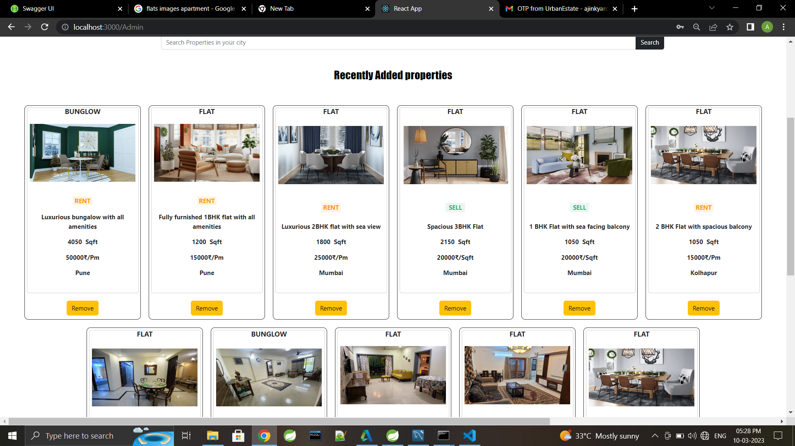
Admin dashboard

Slide 24
specifications
The application will use JavaScript, jQuery and CSS as main web technologies.
HTTP protocols are used as communication protocols. Client can access it via HTTP protocol.
SMTP protocol is used for Email communication.
Several types of validations make this web application a secured one.
Since UrbanEstate is a web-based application, internet connection must be established.
The UrbanEstate will be used on PCs and will function via internet or intranet in any web browser.

Slide 25
Software and hardware requirement
Server Side:
Processor: Intel® Xeon® processor 3500 series
HDD: Minimum 500GB Disk Space
RAM: Minimum 4GB
OS: Windows 10, Linux 6
Database: MySQL
Client Side (minimum requirement):
Processor: Intel Dual Core
HDD: Minimum 80GB Disk Space
RAM: Minimum 2GB
OS: Windows 7, Linux

Slide 26
Future scope
This platform can be enhanced further by integrating payment gateway for customers In order to pay rent online
Relevant services support like packing and moving, Pest control, Electrification and plumbing, Cleaning etc. could be added further.
Customers will be able to make rental agreement on this platform which would include document verification.

Slide 27
conclusion
This platform includes designing and developing a digital platform that allows certified sellers to advertise their properties online and allows customers to visit the properties online with ocean of data regarding the property.
This will aid customers with buying and renting legal properties verified with our legal team in accordance with rules and regulations everything online.

Slide 28

references
https://bootstrapmade.com/mentor-free-education-bootstrap-theme/
https://www.javatpoint.com/java-mail-api-tutorial
https://www.w3schools.com/
https://javaee.github.io/javaee-spec/javadocs/
https://reactjs.org/docs/
https://docs.oracle.com/javaee/7/api/toc.htm

Slide 29
Thank you

